Slide 1
Following hard after Jesus
Love God
Love people
Love in action
Worship and pray
Engage with the Bible
Looking after it
Naturally supernatural
Relationships
Doing church
Who I am and what I’m for
Reach Out

Slide 2
Following hard after Jesus
Love God
Love People
Love in Action
Worship and pray
Engage with the Bible
Looking after it
Naturally supernatural
Relationships
Doing church
Who I am and what I’m for
Reach Out

Slide 3
Following hard after Jesus
Love God
Love People
Love in Action
Worship and pray
Engage with the Bible
Looking after it
Naturally supernatural
Relationships
Doing church
Who I am and what I’m for
Reach Out

Slide 4
Following hard after Jesus
Love God
Love People
Love in Action
Worship and pray
Engage with the Bible
Looking after it
Naturally supernatural
Relationships
Doing church
Who I am and what I’m for
Reach Out

Slide 5
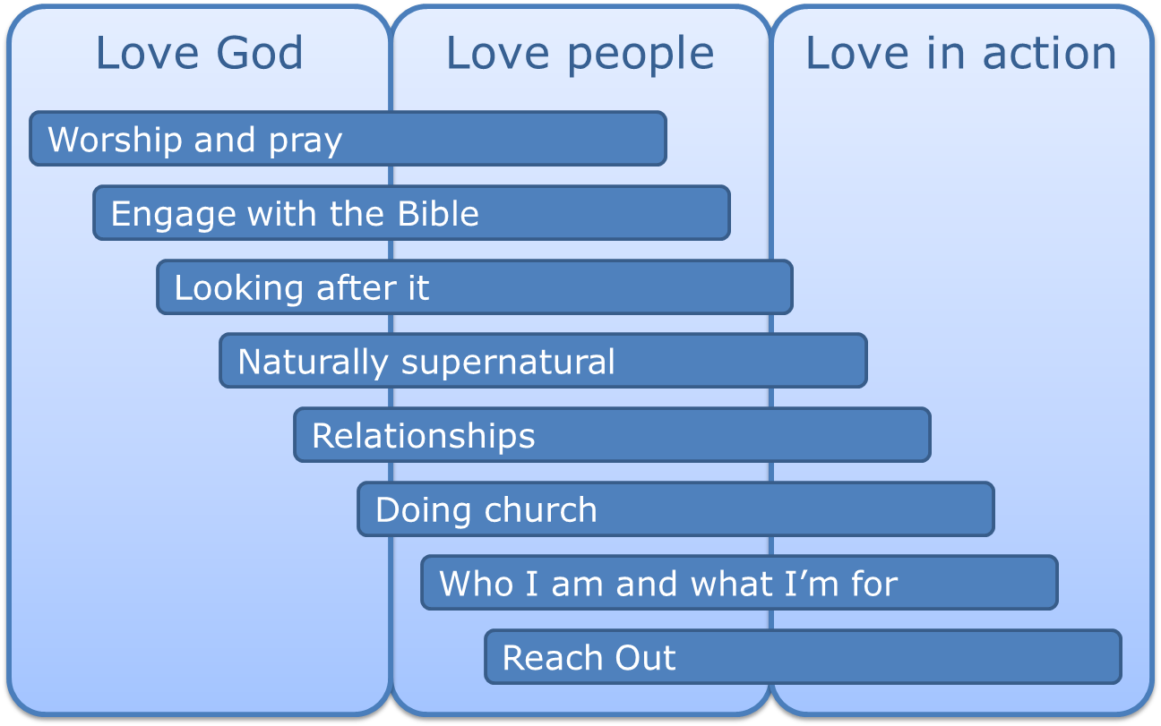
A follower of Jesus
nurtures a personal intimacy with the Lord throughout the day and sets time aside regularly for relationship with Him through worship and prayer
A follower of Jesus
engages with and applies the Bible for all its worth
Following Jesus
A follower of Jesus
hears from God and prays for people in a naturally supernatural way
A follower of Jesus
looks after their money, their body, their time, their integrity and the world around
A follower of Jesus
participates and engages in church and accountable small group relationships
A follower of Jesus
is in increasingly good relationships with everyone they interact with
A follower of Jesus
knows who they are and what they're for
and focuses on that
A follower of Jesus
reaches out to people beyond their circle of comfort

Slide 6
Following hard after Jesus
Love God
Love People
Love in Action

